Slide 1
Verbal arithmetic!
Robitu Riana & Tănase Irina

Slide 2
What we’re going to be talking about:
What is verbal arithmetic?
How to solve a cryptarithm
Why is it important in scientific fields?
Some implementation ideas
Relevant nitpickeries and explanations
Our approach
Historical context

Slide 3
What is verbal arithmetic?
Also known as “word addition”, or “cryptarithm”, it is a mathematical puzzle/equation, where numbers are represented by letters, and the goal is to identify the value of each letter (It is not always latin letters, but you get the point). The equation is most commonly addition, but it can be extended to multiplication, division, etc.
There are multiple types of cryptarithms: Alphametic, Digimetic and skeletal divisions used in teaching elementary algebra.

Slide 4

Basic rules of the verbal arithmetic puzzle:
It is fairly simple!
1. Each letter corresponds to only one digit.
2. First digit of the number can not be 0. For example, “76” can not be written as “076” or “0076”.
Here is one simple example:

Slide 5

How to solve a cryptarithm
We’re going to be solving Dudeney’s famous cryptarithm together (well, we’re going to walk you through the solution).
1. From column 5, we can tell that “M” is equal to 1, since it is the only possible option.
2. “O” must be <= “M”, since we have a carry, and it cannot be 1, so it is safe to say that “O” = 0.

Slide 6
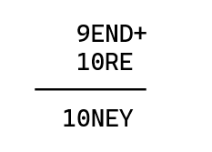
How to solve a cryptarithm
3. Since “M” - “O” = 1, “S” would be either 8 or 9, depending on the presence of a carry in column 4. If we had a carry there, it would mean that “O” >= “M” (impossible, since “O” is 0), so “S” is 9.
4. We know for sure there is a carry on column 3, because “E” + 0 = “N”, and E cannot be equal to N. Now we learn that E + 1 = N.

Slide 7
How to solve a cryptarithm
5. It is possible that there is a carry on column 2, but we do not know for sure. If there isn’t, then (N + R) % 10 = E, but E + 1 = N, so (E + 1 + R) % 10 = E, so (R + 1)%10 = 0. That leaves us with “R” = 8 or “R” = 9 (taken number), so “R” = 8.

Slide 8
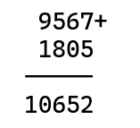
How to solve a cryptarithm
6. “D” + “E” = 10 + ”Y” (since we are sure to have a carry on the next column), “Y” >= 2 since 1 and 0 are taken, so “D” + “E” >= 12. The two options would be (5, 7), and (6, 7). “N” = “E” + 1, so “E” can not be 7 ( 8 is already taken ), therefore we only have one option left: “D” = 7, “E” = 5, “N” = 6, and “Y” = 2.
The final equation is 9567+1085=10652.

Slide 9
The importance of verbal arithmetic in scientific fields
It is part of the P vs NP problems, being NP-complete.
This means that:
It is a decision problem;
When the answer is “yes”, it can be checked and demonstrated in polynomial time;
It takes a long time to check if a solution exists (which is a permutation problem in this case, of time complexity O(n^{n})).
Demonstration of brute force, backtracking and constraint programming algorithms :)

Slide 10
Relevant nitpickeries and explanations
Cryptarithms have been used since the 1800s as a way to demonstrate the brute force approach;
Naively, one would say that a cryptarithm can be interpreted as a linear system (in the way we perceive it mathematically), but it is not, due to the constraints placed on the values (integrality, range and uniqueness);
This means that they’d be more accurately called linear programming problems (instead of linear systems), and integer linear programming is actually NP-hard (NP-complete in this case, since it’s obvious that a solution can be verified in polynomial time).

Slide 11
Some implementation ideas - what is the most efficient way to solve the problem?
One of the most efficient solutions that we could find online was created for a Leetcode problem and we decided to study it and understand how the programmer approached the concept of verbal arithmetics.
This solution is quite unique, as it assigns a coefficient to each letter, which represents the sum of its positions across all words. It then tries to find the values for the letters with the biggest coefficients, using a depth-first-search type of algorithm, using cumulative sums to stop the branches that are sure to fail, which saves time.

Slide 12
Some implementation ideas - what is the most efficient way to solve the problem?
Another way to solve this problem would be the constraint programming method, for which we found a variant in Java using Choco3. While we're not Java programmers, we found this solution interesting. It offered a new way to approach the problem, quite different from the methods we're more familiar with.
https://github.com/chocoteam/choco3 for more informations about the lib used.

Slide 13
Our approach
First step: we tried solving the Leetcode problem in python (and succeeded).
https://leetcode.com/problems/verbal-arithmetic-puzzle/description/
Second step: we tried tweaking the problem and finding a polynomial solution using constraint programming and some other silly ideas we had
How did that go?

Slide 14

Bad :(

Slide 15
Our approach
After thinking about the problem for a while and researching other ideas and implementation, we decided to use Prolog, since the language itself is based on built-in constraints and backtracking, so it makes it kind of intuitive.

Slide 16
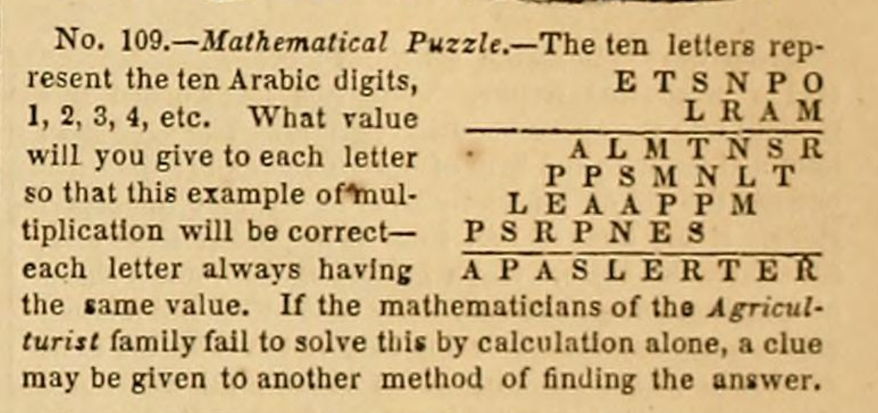
Historical context
We would like to show you the first cryptarithm dated in 1864 published in “American Agriculturist”

Slide 17
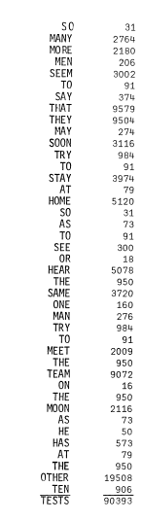
Historical context
Another one published in “Crux Mathematicorum” (canadian paper). It has 41 words and its unique solving key has been computer checked.

Slide 18
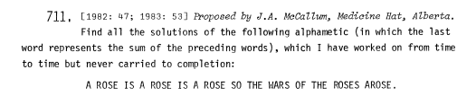
Historical context
However, this one from the same paper as the before mentioned has not been solved by the author:
We managed to find a solution for it: A → 4 R → 2 O → 5 S → 0 E → 8 I → 7
T → 1 H → 3 W → 9 F → 6.

Slide 19
Conclusions
After this period of researching, we came to terms with the fact that this kind of problem is really hard to solve efficiently, since it serves as such a great example for backtracking-based problems, making it not the easiest approach for solving a P vs NP problem.
Despite this, the research and getting accustomed to the problem was a really fun process since cryptarithms are enjoyable exercises for us to solve using modular arithmetics!

Slide 20
Thank you for listening!
:D

